Slide 1
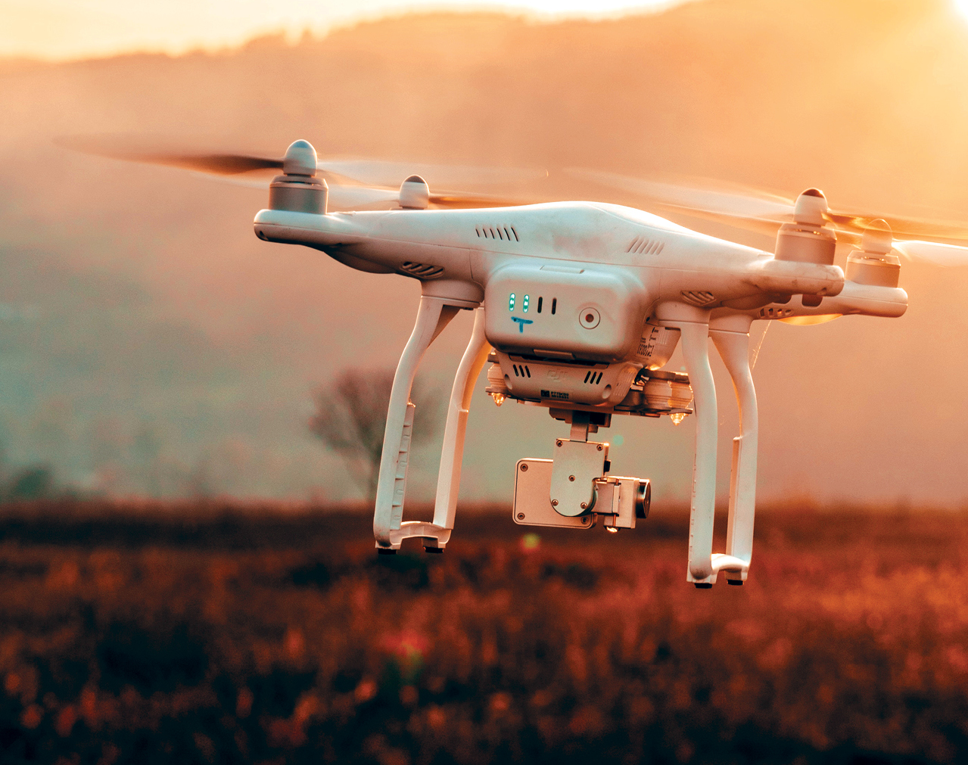
Data, Drones, and Agriculture David Blumenstiel Data 607 Data Science in Context Presentation 03/11/2020
https://www.geospatialworld.net/article/what-are-popular-uses-of-drones/

Slide 2
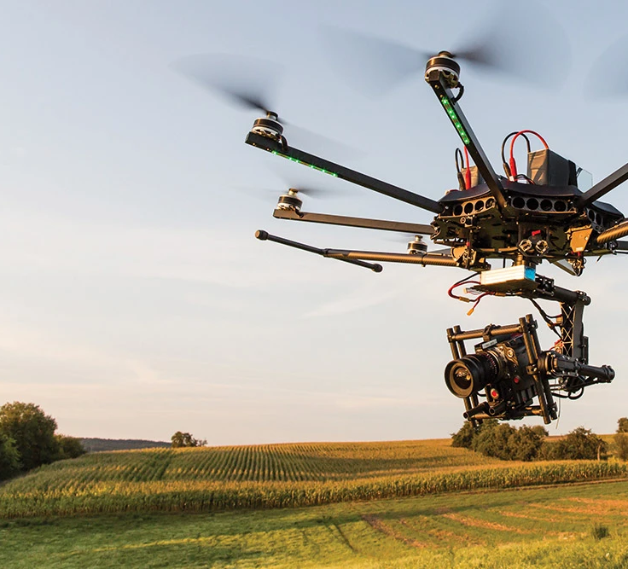
What’s it About?
Agriculture usually relies on human observation
Error Prone
Slow
Can replace human observation with drone surveillance
More accurate
Faster
Process the info into insights for farmers
‘Agri-Tech’
https://www.kdedirect.com/blogs/news/agricultural-drone-market

Slide 3
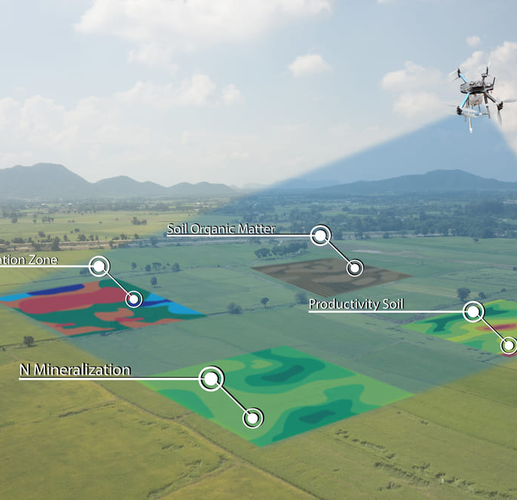
How’s it Work?
Areal Imaging
Multispectral cameras/LIDAR
Spatial Information
Image recognition
https://dzone.com/articles/why-use-agriculture-drones-main-benefits-and-best

Slide 4
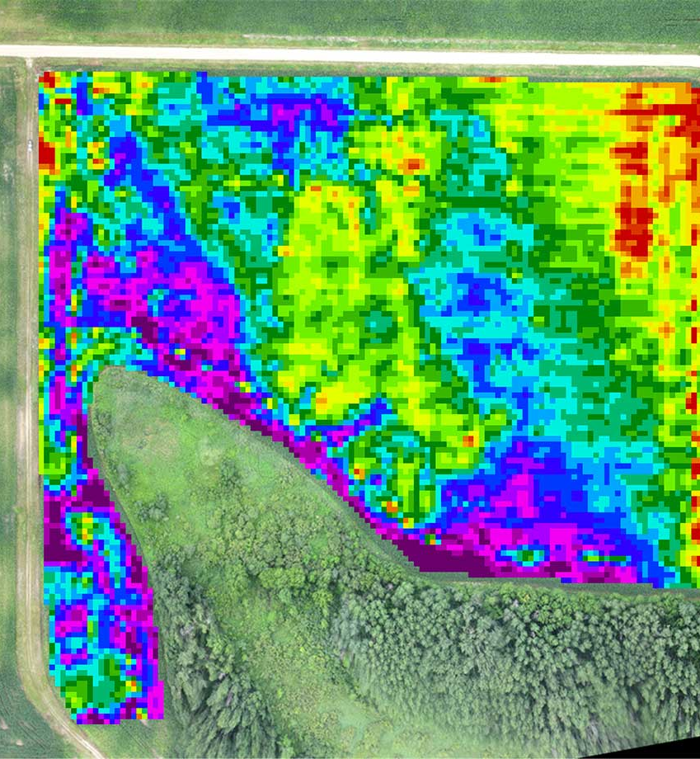
What’s it Give You?
Maps and visualizations of:
Plant health
Disease
Nutrient content
Soil quality
Elevation
Yield
Growth progress
Visualizations that save time and resources
https://waypoint.sensefly.com/drone-surface-model-estimate-crop-yield-plant-health/

Slide 5
Quick list of web sources:
Informational:
https://hackernoon.com/how-drones-are-transforming-big-data-analytics-gszq30tr
https://www.precisionhawk.com/agriculture
https://geoawesomeness.com/helping-farmers-move-from-analog-to-digital-farming-with-drones-and-remote-sensing/
Slide 0 Image
https://www.geospatialworld.net/article/what-are-popular-uses-of-drones/
Slide 1 Image
https://www.kdedirect.com/blogs/news/agricultural-drone-market
Slide 2 Image
https://dzone.com/articles/why-use-agriculture-drones-main-benefits-and-best
Slide 3 Image
https://waypoint.sensefly.com/drone-surface-model-estimate-crop-yield-plant-health/

